Slide 1
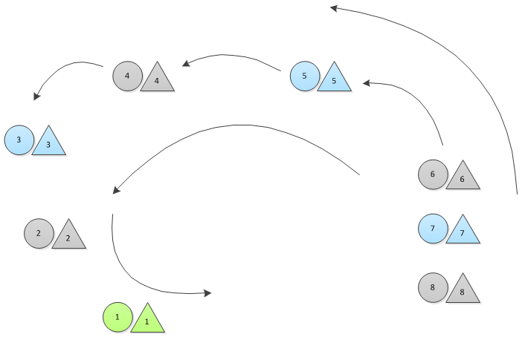
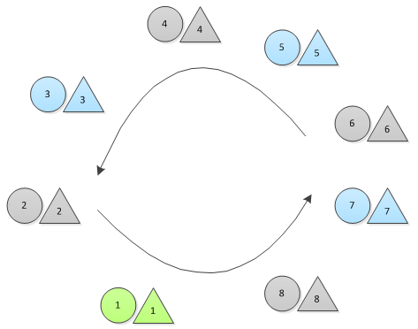
The Figure Dance
1
Promenade in, girls to the right of their partners
Form main circle
Stop when the music stops
2

Slide 2
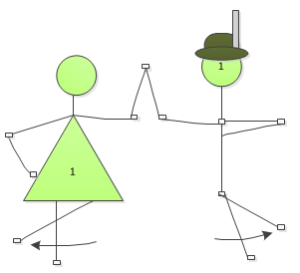
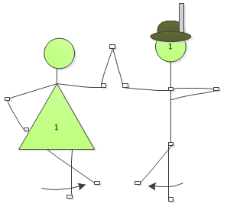
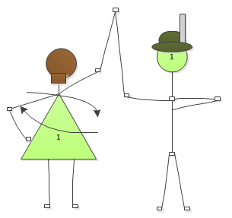
Music Starts
1
Guys kick right foot to the left, left foot to the right
Girls kick left foot to the right, right foot to the left, then spin twice
Guys stomp, girls stop spinning
All start moving in the circle again, girls spinning, guys shuffling their feet
2
3

Slide 3
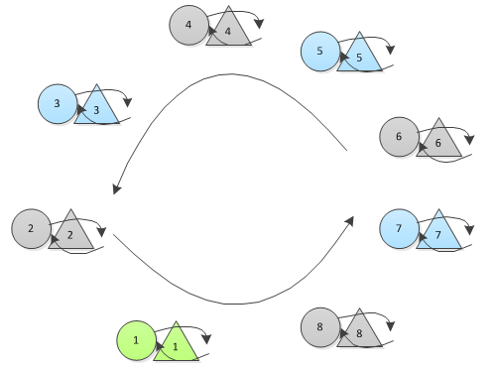
Music starts
All begin moving in the circle again
  Guys shuffle their feet
  Girls spin

Slide 4
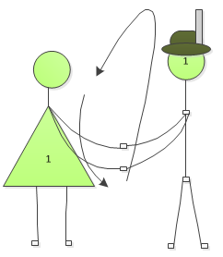
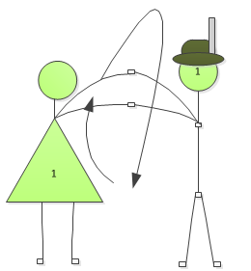
STOMP
1
“Rollover spin”
All stop moving in circle, girls stop spinning
Turn to your partner and take both hands
Rollover to the outside first, then the inside and repeat
2

Slide 5
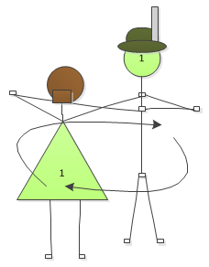
STOMP
“Behind guy’s neck”
Guy’s left hand and girl’s right hand behind guy’s neck
Guy’s right hand holds girl’s left hand out in front of him
Partners circle each other
At next stomp, switch to the other side

Slide 6
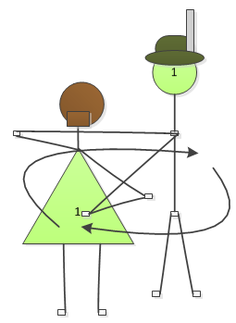
STOMP
“Behind girl’s back”
Guy’s left hand holds girl’s right hand behind her back
Guy’s right hand holds girl’s left hand in front of him
Partners circle each other
At next stomp, switch directions

Slide 7
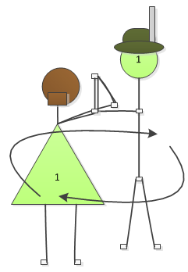
STOMP
“Windows”
Partners make “windows” with their arms
Partners circle each other
At next stomp, switch directions

Slide 8
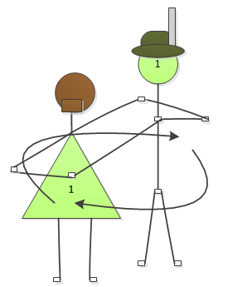
STOMP
“Neck-to-Back”
Guy’s left hand holds girl’s right hand behind his neck
Guy’s right hand holds girl’s left hand behind her back
Partners circle each other
At next stomp, switch directions

Slide 9
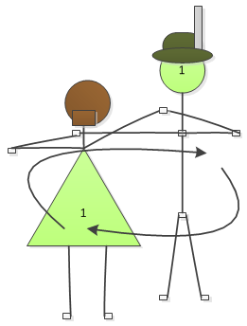
STOMP
“Neck-to-neck”
Guy’s left hand holds girl’s right hand behind his neck
Guy’s right hand holds girl’s left hand behind her neck
Partners circle each other
At next stomp, switch directions

Slide 10
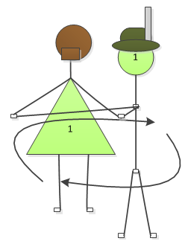
STOMP
“Back-to-back”
Partners put their backs to each other
Guy holds girl’s right hand in his left hand and girl’s left hand in his right hand
Partners each step to the left so they are offset from each other
Partners circle each other, facing away from each other
At next stomp, switch directions

Slide 11
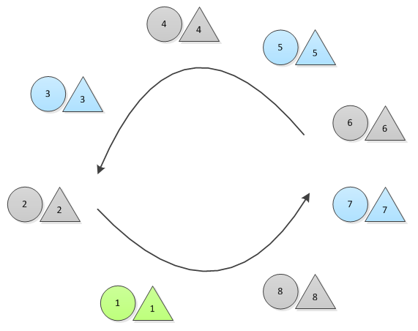
STOMP
Partners link girl’s left pinky with guy’s right pinky
  Guys, left hand to suspenders
  Girls, right hand on hip
All begin to move around main circle again
Stop moving when music stops

Slide 12
Music Starts
1
Guys kick right foot to the left, left foot to the right
Girls kick left foot to the right, right foot to the left, then spin twice
Guys stomp, girls stop spinning
2
3

Slide 13
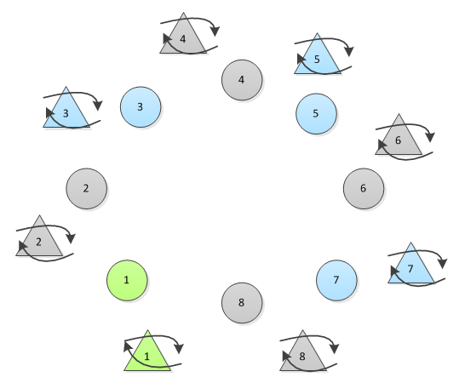
Music Continues
Guys remain in the main circle and begin plattling
Girls are outside of the circle, behind their partner but offset from them to be a little ahead of them in the circle. Girls hold their apron and spin

Slide 14
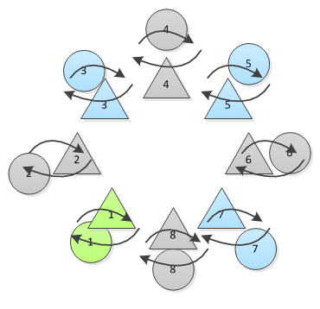
STOMP
Guys move to their partners and catch them
Couples dance together

Slide 15
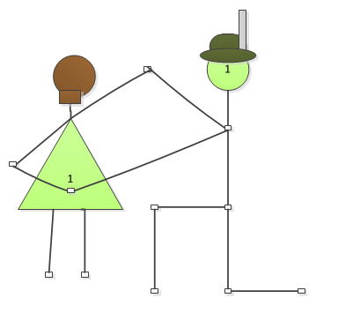
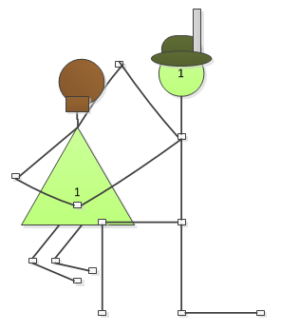
STOMP
1
Guys spin girls around and then take a knee
  Girl’s left hand holds guy’s right hand behind her back
  Girl’s right hand holds guy’s left hand in front of her
As music finishes, girls sit on their partner’s knee
2

Slide 16
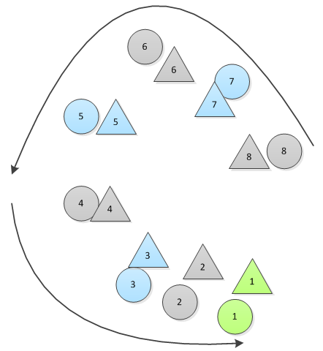
Music starts, then stomp
Girls stand, join right pinkies with their partner’s left pinky as guys stand
All promenade out
END

