Slide 1
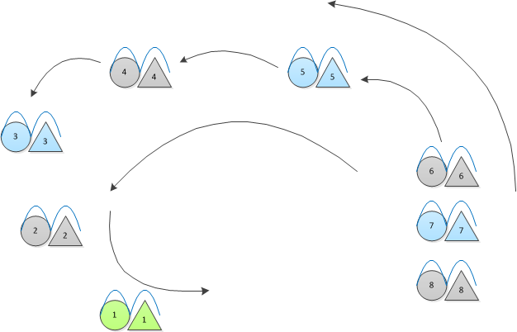
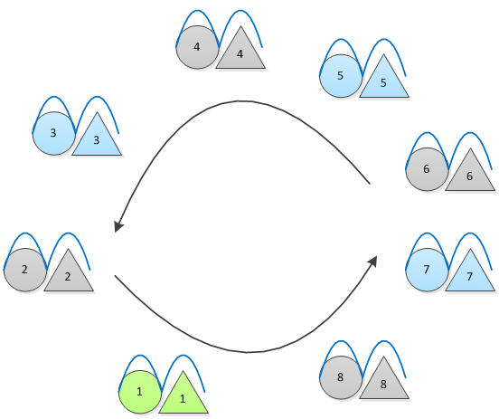
The Crown Dance
1
Promenade in holding own bow and partner’s pinky (girls on the guys’ right)
Form circle and keep walking in line
Continue walking, no stop in this dance
2

Slide 2
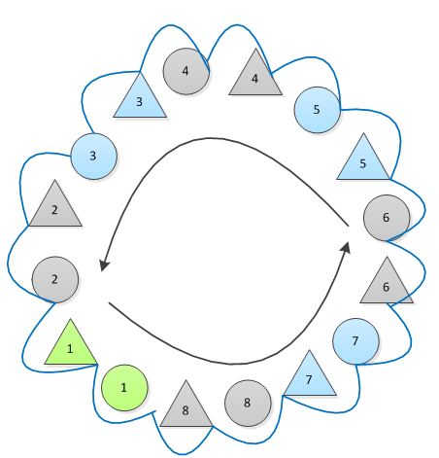
STOMP
Guys reach left hand forward, Girls reach right hand back, join pinkies with next couple
Circle is completed with everyone facing out
Continue moving in the circle

Slide 3
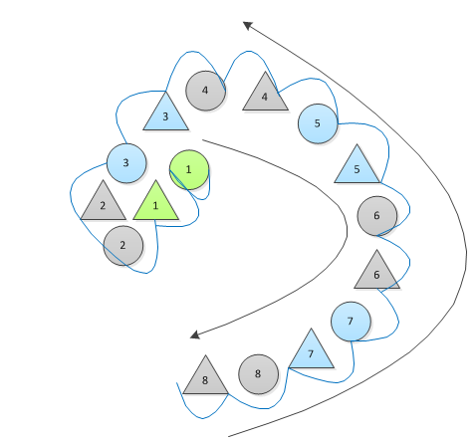
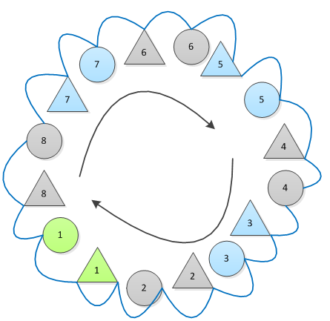
STOMP
1
“Snake”
Leader breaks off as the head of the “snake” and leads the rest of the group along close to the “body”
Stay close, back-to-back with others
Reform circle, facing in and moving in the opposite direction
2

Slide 4
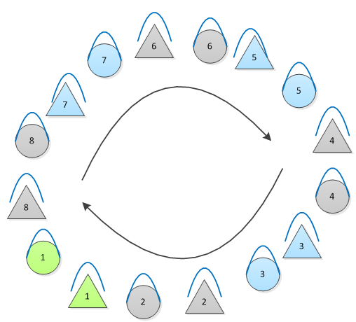
STOMP
“Main Circle”
Release pinkies with neighboring couples
Girls follow their partner around the circle

Slide 5
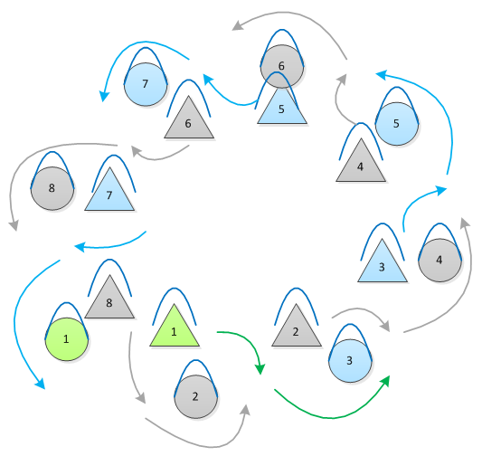
STOMP
“Weave”
Girls immediately step back with their right foot and begin to weave
  Move to the right of the first guy behind you
  Move to the left of the second guy behind you
  Repeat all the way around the circle
While weaving, turn smoothly, and make sure that you are back-to-back with the person you are weaving around

Slide 6
STOMP
Girls fall in behind their partner, re-form main circle

Slide 7
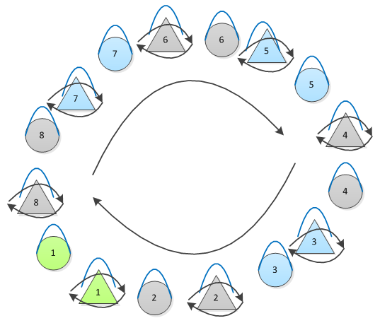
STOMP
Girls immediately begin to Spin to the right
All continue to move in the circle while girls spin

Slide 8
STOMP
Girls stop spinning, follow partner
All walk in “Main Circle”

Slide 9
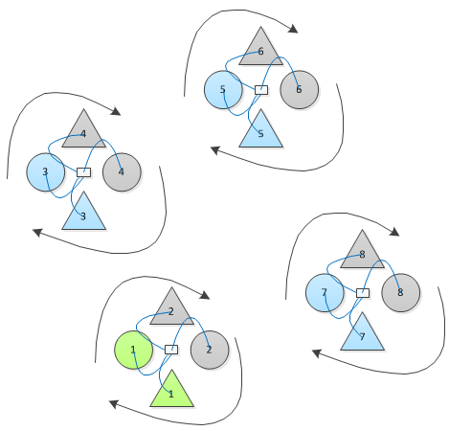
STOMP
“Groups of Four - Pinwheels”
Move out of main circle (girls follow their partners) into four groups of four
  Couples 1 & 2 together
  Couples 3 & 4 together
  Couples 5 & 6 together
  Couples 7 & 8 together
  (If there are only six couples in the dance, there will only be three groups of four)
In each circle, everyone puts their right hands together at the center of the circle and continues to rotate

Slide 10
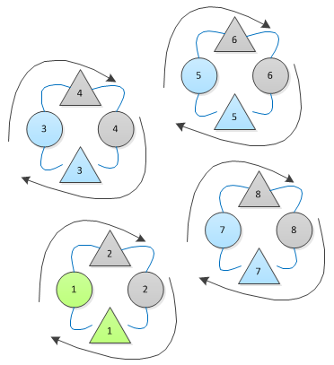
STOMP
“Groups of Four - Circles”
In the same group of four, all turn to the center and link pinkies. Continue to rotate in the circle

Slide 11
STOMP
Girls follow their partners back into “Main Circle”

Slide 12
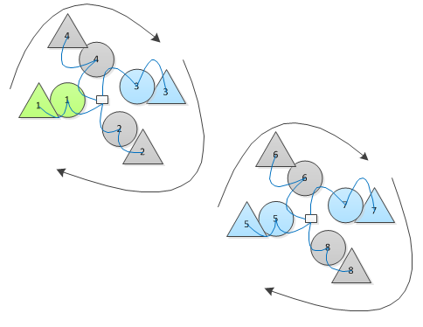
STOMP
“Groups of Eight - Pinwheels”
Move out of main circle into two groups of eight.
  Couples 1, 2, 3, & 4 together
  Couples 5, 6, 7, & 8 together
  (If there are only 6 couples in the dance, there will be two groups of six instead of two groups of eight (couples 1, 2, & 3 together and couples 4, 5, & 6 together)
Girls move to the outside of their partner and link pinkies
Guys put right hands into the center of the circles

Slide 13
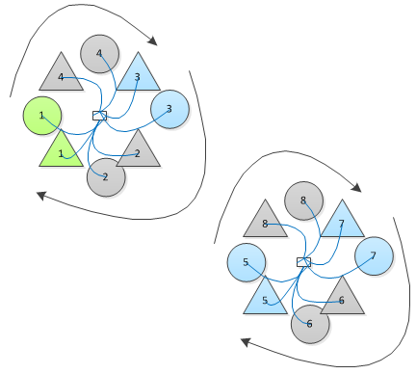
STOMP
“Groups of Eight – Mini Crowns”
In the same groups, girls drop behind their partners.
All join right hands at the center of the circle.
  Girls’ bows are low
  Guys’ bows are high
Continue rotating in the circles

Slide 14
STOMP
Girls follow their partners back into “Main Circle”

Slide 15
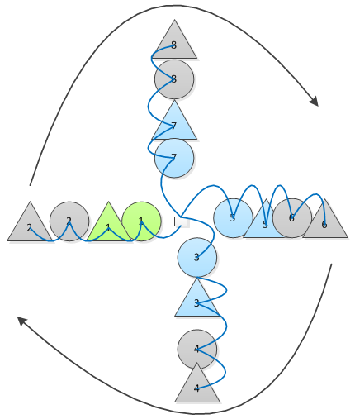
STOMP
“Big Pinwheel”
Girls go to outside of their partner, join pinkies
Odd numbered couples stay inside and guys put fists together in center
  Walk very slowly so even numbered couples can catch up
Even numbered couples move to the outside of the couple in front of them, join pinkies
(If there are only six couples in the dance, the “pinwheel” will only have three arms (watch spacing)

Slide 16
STOMP
Girls follow their partners back into “Main Circle”
Watch spacing here, as in the next step dancers will pass bows to the people in front/behind them

Slide 17
STOMP
Pass bows
Pass the handle of the bow in your left hand to the right hand of the person in front of you
Accept the bow from the person behind you in your right hand, but don’t look back at them.
Hold bow handles in right hand
  Guys: Left hand to suspenders, elbows up
  Girls: Left hand on hip, elbows out

Slide 18
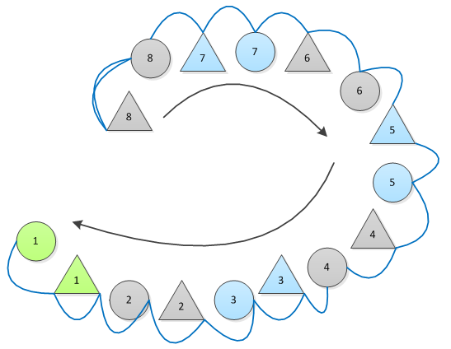
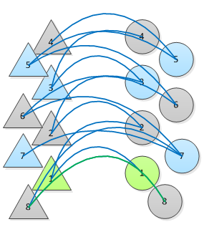
Stomp?
“Bridge”
Leader passes his bow to couple #8 (couple # 6 if there were only six couples in the dance)
Follow the leader out of the circle
Leader stops, partner stops beside him couples 1-4 stop in line, couples 5-8 “leapfrog” the couples in front of them
  Girls switch bows into left hand before moving into bridge
  Keep elbows in for this part
  Stay as close together as possible
  If there are only six couples, then couples 1-3 will stop in line and couples 4-6 will “leapfrog” with couple 6 ending in the front of the bridge
1
2

Slide 19
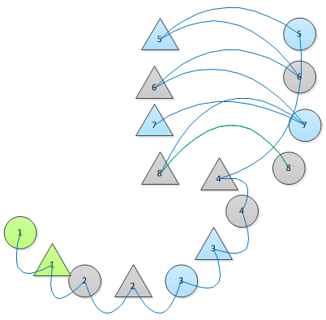
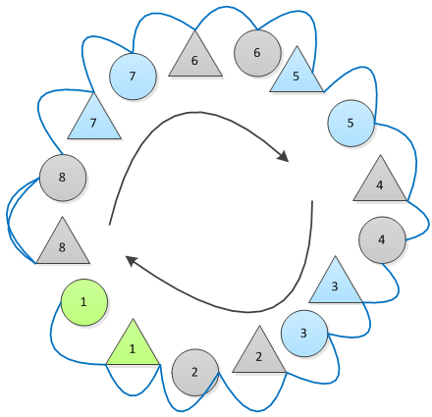
STOMP
1
“Bridge” pt. 2
At the stomp, everyone raises their bows as high as they can
Follow the leader out of the bridge and back into the circle with shared bows
  Girls switch bows back to right hand when moving out of bridge
  Don’t duck your head when walking under bows
Once back in the circle, leader retrieves his bow from last couple
2

Slide 20
STOMP
Take back your own bow by reaching forward with your left hand and taking it from the right hand of the person in front of you
Smoothly turn forward and walk in the Main circle formation. Try not to fiddle with your bow once it is back in your hands

Slide 21
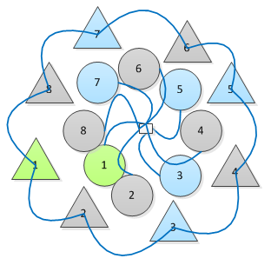
STOMP
“Big Crown”
Girls move outside and slightly in front of their partner. Girls face in to the circle and join pinkies with girl in front and behind them. Keep bows low.
Guys stay in the middle and put rights fists into center of circle. Raise bows up and put left elbows between the bows of two neighboring girls.

Slide 22
STOMP
Girls follow their partners back into main circle

Slide 23
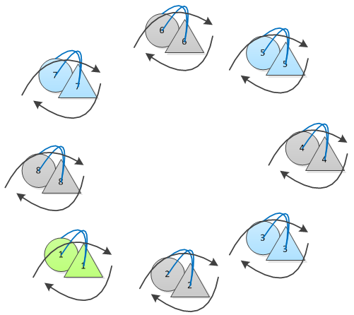
STOMP
Dance with partner
Guy’s right elbow under girl’s left elbow
Girls’ bow under guy’s bow - girl pushes up with bow, guys pulls down with bow to keep them steady

Slide 24
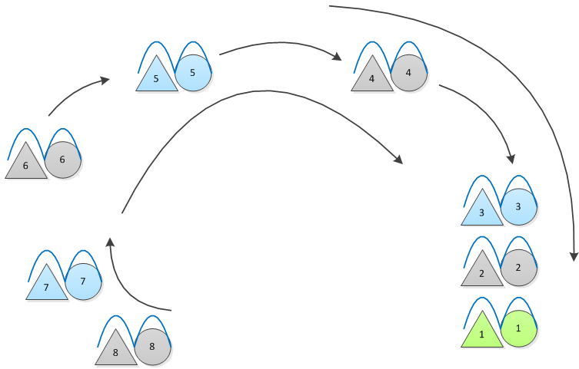
STOMP
Girls to the right of their partners, join pinkies
Follow the leader to promenade out.
END

