Slide 1
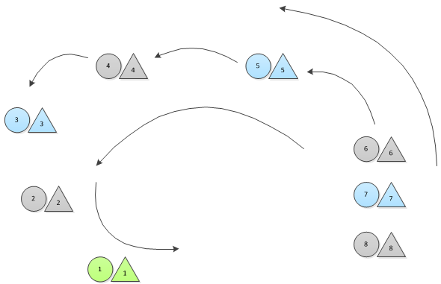
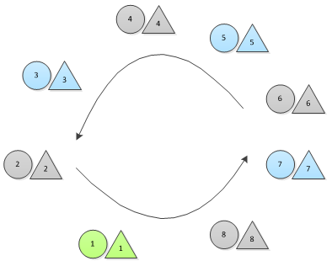
Mühlenrod Dance
1
Promenade in holding pinkies with partner, girls to the right of the guys
Guys stomp in rhythm during this dance
Form circle, and continue walking, no stop in this dance
2

Slide 2
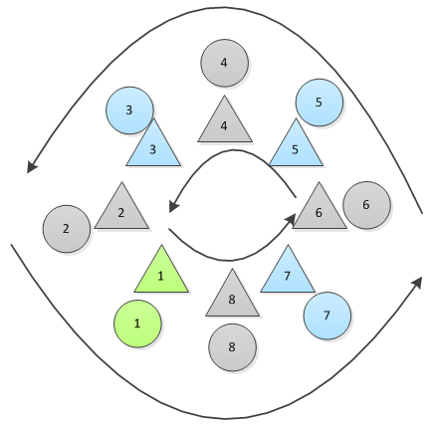
STOMP
Girls step in front of their partner, face him, and hold his thumbs
Girls join pinkies with the girls in front of and behind them, guys join pinkies with guys in front of and behind them
All continue moving in the circle

Slide 3
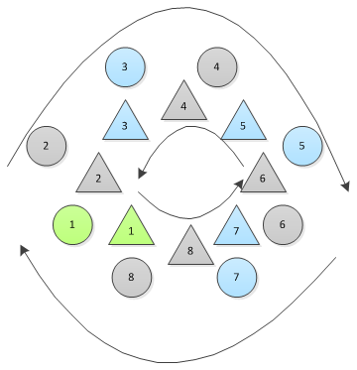
STOMP
Girls release guys’ thumbs, but keep pinky links with other girls, guys keep pinky links with other guys
Guys move their circle in the opposite direction, girls continue to move their circle in the same direction

Slide 4
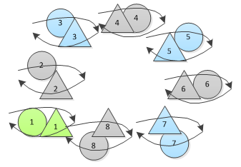
STOMP
Release pinkies as you meet your partner. Join right pinkies with your partner and circle each other
  Elbows should be in the “window” position (resting on partner’s shoulder)

Slide 5
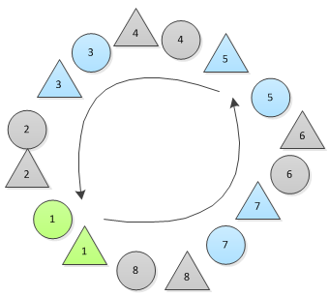
STOMP
File into a circle, with girls moving ahead of their partners
Girls face out of the circle, guys face into the circle
Everyone grabs forearms in preparation for the girls holding up the guys in the next step

Slide 6
STOMP
Guys lean back and girls hold them up

Slide 7
STOMP
Girls pull guys back up
Instead of forearms, hold pinkies with those ahead of and behind you in circle
Face forward
  Girls: Left hand reaches straight forward to hold the left pinky of the guy in front of you. Right arm is bent, hand right by your head holding the right pinky of the guy behind you.
  Guys: Right hand reaches straight forward to hold the right pinky of the girl in front of you. Left arm is bent, hand right by your head holding the left pinky of the girl behind you.

Slide 8
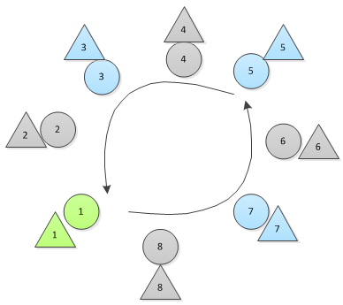
STOMP
Continue moving in a circle
Release pinkies except continue to hold your partner’s pinky
  Girl’s right pinky to guy’s right pinky
  Girl’s right arm goes over her head to her partner
  Girls’ left hands to hips
  Guys’ left hands to suspenders
Guys should still be stomping in rhythm at this time

Slide 9
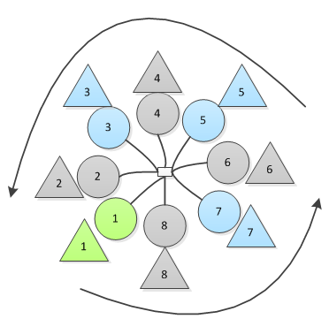
STOMP
Continue moving in the circle
Guys reach their left hands to the center of the circle, all join pinkies
Girls keep right arm overhead joined with guys’ right arm

Slide 10
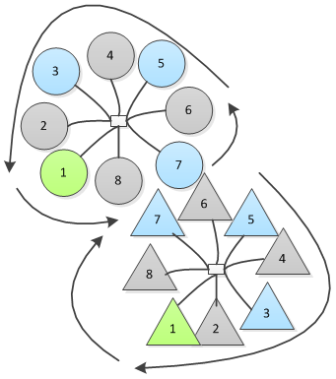
STOMP
Following the lead girl, girls one by one break off from the circle and join their own circle
Girls join pinkies/thumbs of right hand at center of circle
Two circles should move like gears, where the girls move behind their partner when the two circles meet

Slide 11
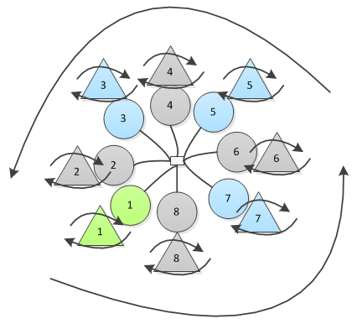
STOMP
When you meet your partner in the circles, girls will break off from the girls’ circle
Girls will join their left hand with their partner’s right hand and will begin to twirl while moving alongside them in the main circle
Guys will continue to have their hands linked at the center (and should still be stomping in rhythm)

Slide 12
STOMP
Girls stop spinning, join their left pinky with partner’s right pinky
All continue moving in circle

Slide 13
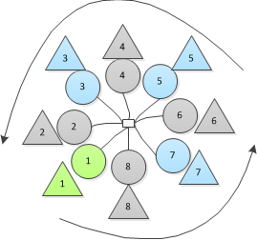
STOMP
Girls reach back with their right hand and take the thumb of the guy behind them
Girls face out of the circle
Guys continue to keep their left hands joined at the center of the circle

Slide 14
STOMP
Guys release their left hands from the center of the circle and instead join the right pinky of the girl in front of them with their left pinky
All move in the circle facing forward
  Girls: Left hand reaches straight forward to hold the left pinky of the guy in front of you. Right arm is bent, hand right by your head holding the right pinky of the guy behind you.
  Guys: Right hand reaches straight forward to hold the right pinky of the girl in front of you. Left arm is bent, hand right by your head holding the left pinky of the girl behind you.

Slide 15
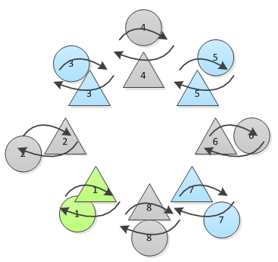
STOMP
Break off from the circle and dance with your partner

Slide 16
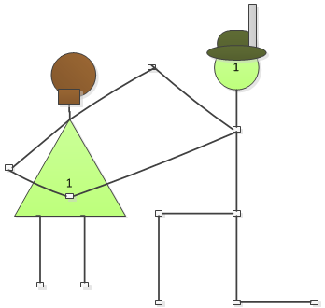
STOMP
Guys spin girls around and take a knee
End with girl’s left hand behind her back, right hand straight out holding their partner’s hand

Slide 17
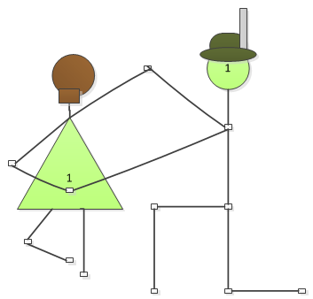
STOMP
Girls curtsy
  Step forward left, right, curtsy (left leg bends to curtsy)
  Step back left, right curtsy (left leg bends to curtsy)
  Repeat until next stomp

Slide 18
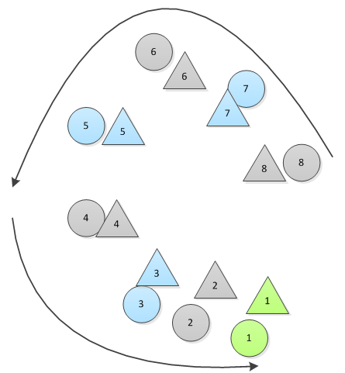
STOMP
Guys stand join left pinkies with their partner’s right pinky
All promenade out
END

